Slide 1
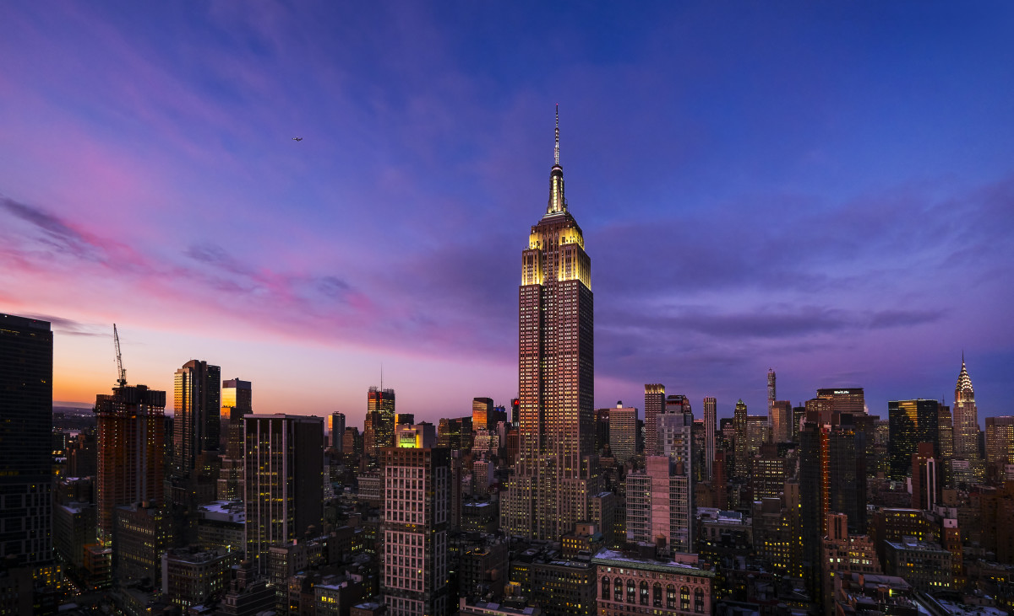

NYPD Motor Vehicle Collision Analysis
Group 13
MBAN Hackathon 2023
Notes:
Good afternoon everyone, welcome to our presentation. We are team 13, I‘m Kai, this is Cyrus, Amanda, and Yingke. Today we are going to talk about our analysis on NYPD Motor Vehicle Collision Analysis.

Slide 2
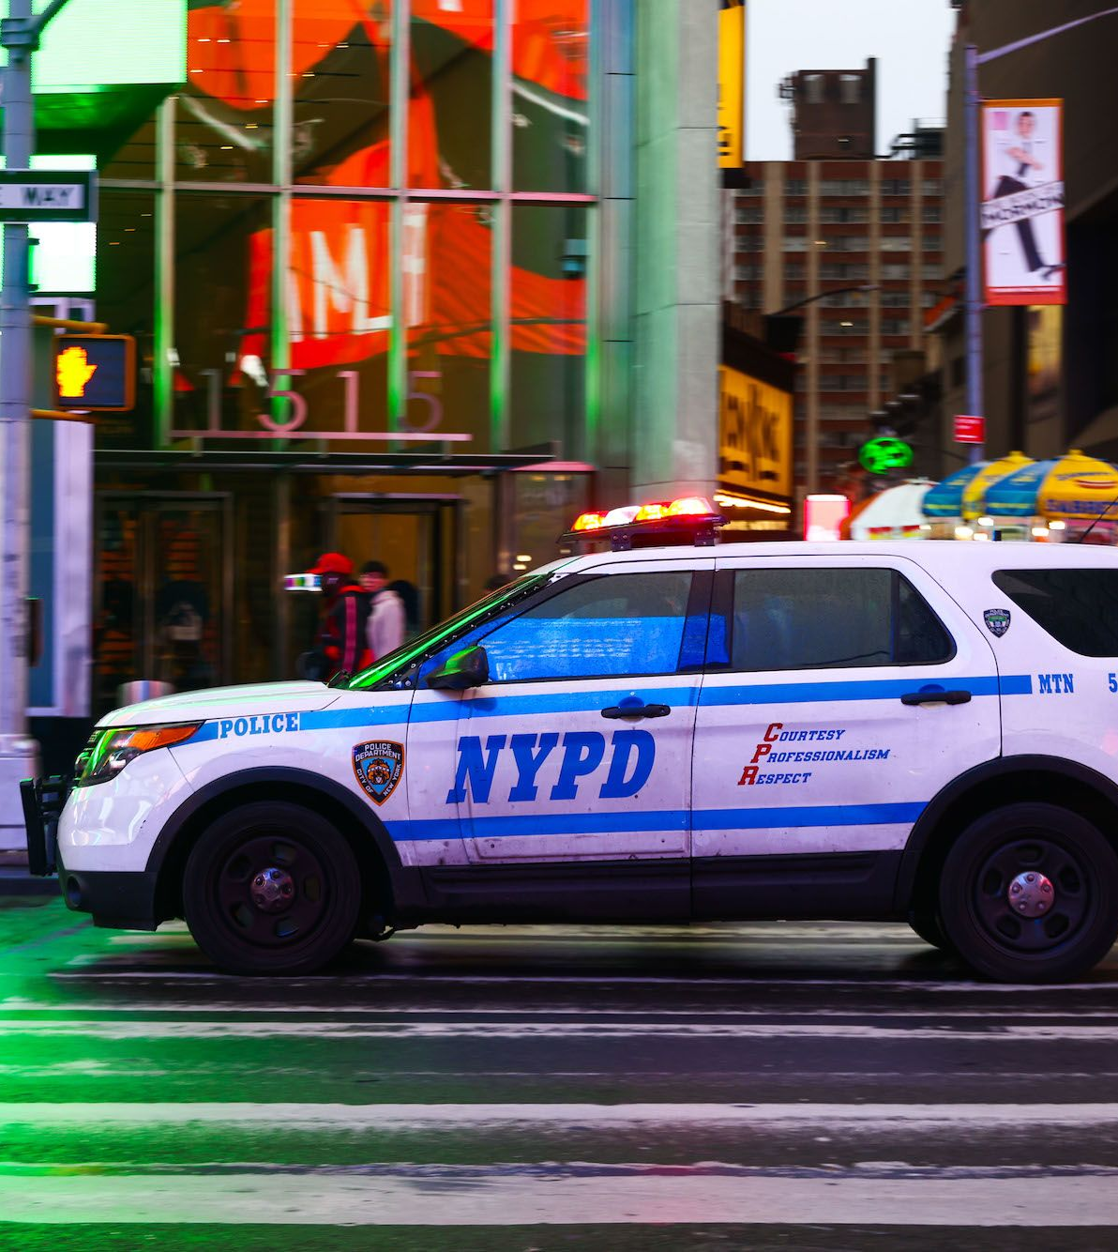
Background
Vision Zero initiative
NYPD Motor Vehicle Collisions Dataset
Dashboard：
https://lookerstudio.google.com/s/nC4FxEd4LOk
2
Notes:
The New York city implemented the Vision Zero initiative in 2014, aiming to reduce the number of car accidents in NYC. As a part of the initiative, we have the NYPD Motor Vehicle Collisions Dataset, that include the details of every accident over the past 10 years. Our team conducted a comprehensive analysis, and created a dashboard.

Slide 3


Exploratory Analysis & Recommendations

Slide 4
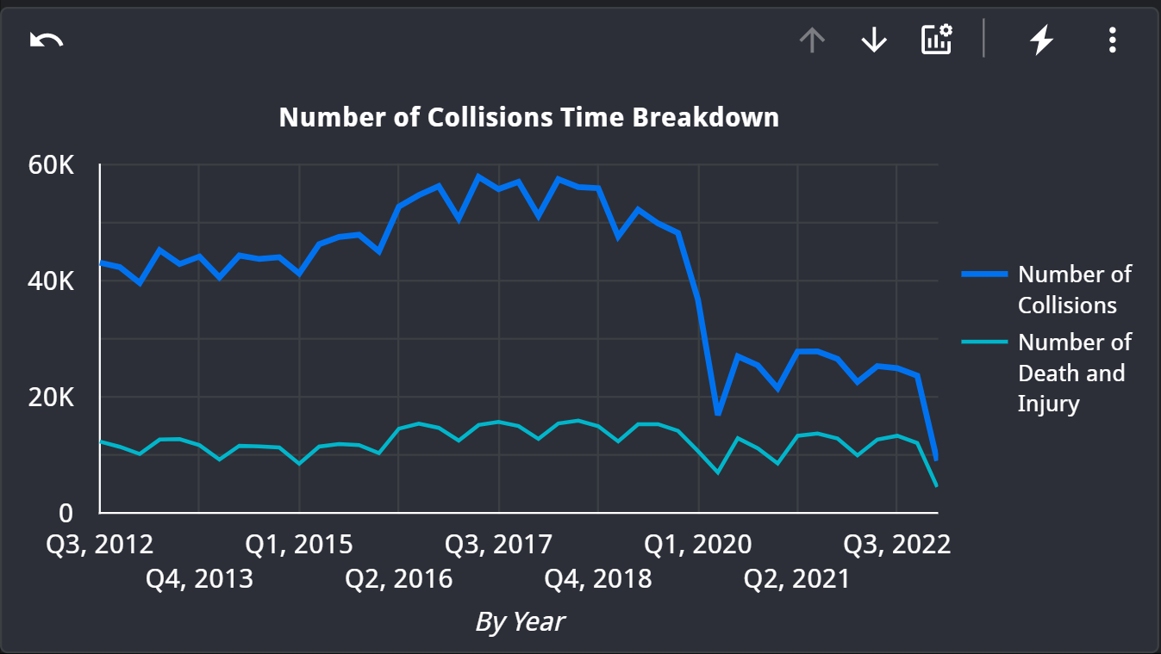
Analysis #1 – Trend
Notes:
road rage

Slide 5
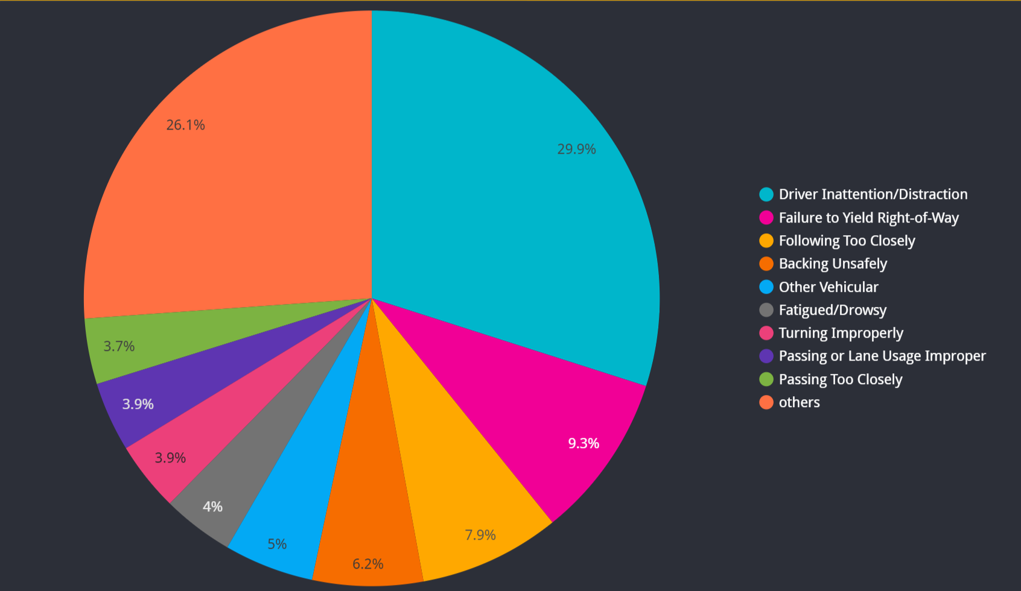
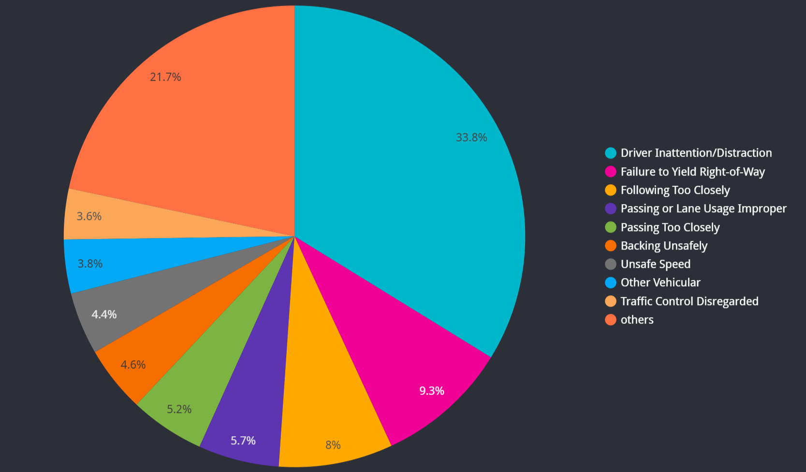
Analysis #1 – Cause Analysis
Contributing Factors BEFORE 2020
Contributing Factors AFTER 2020
Notes:
road rage

Slide 6
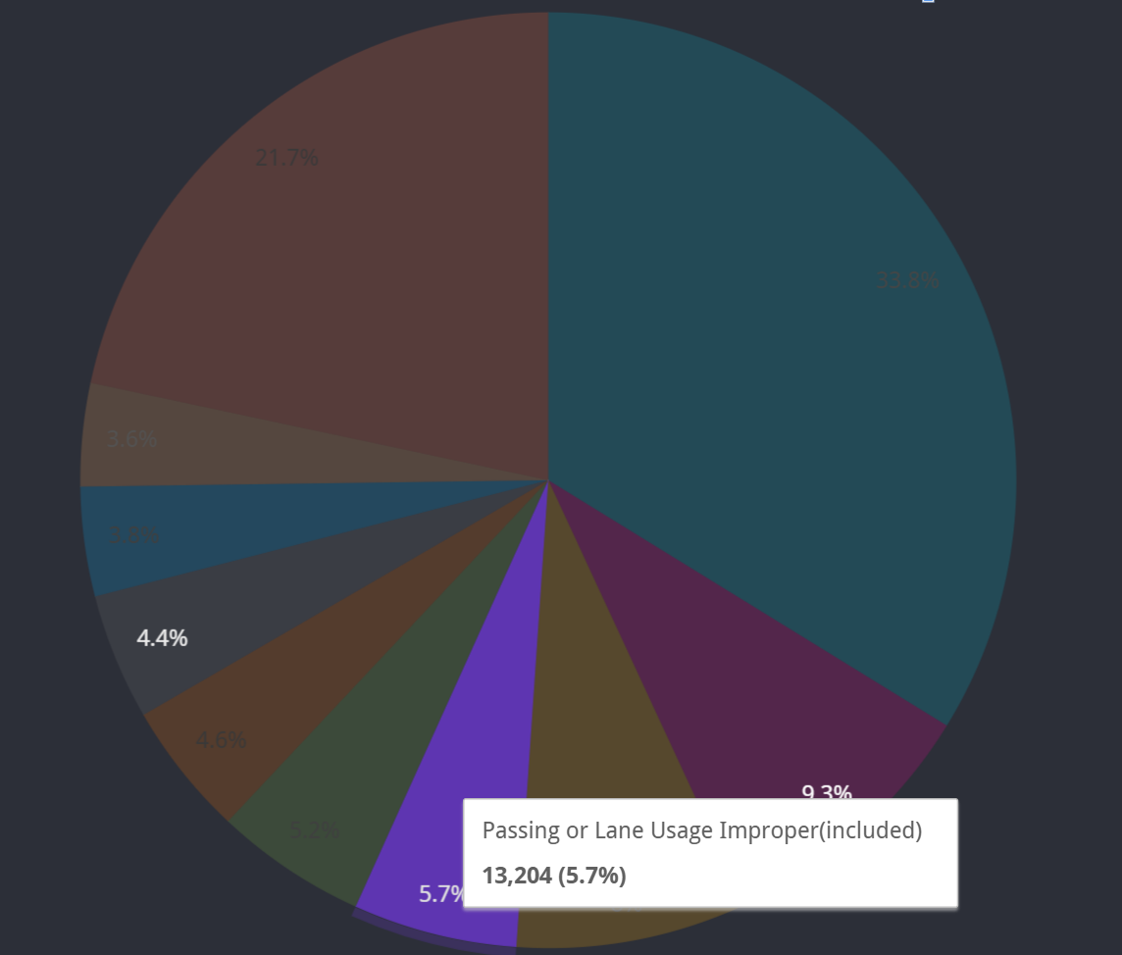
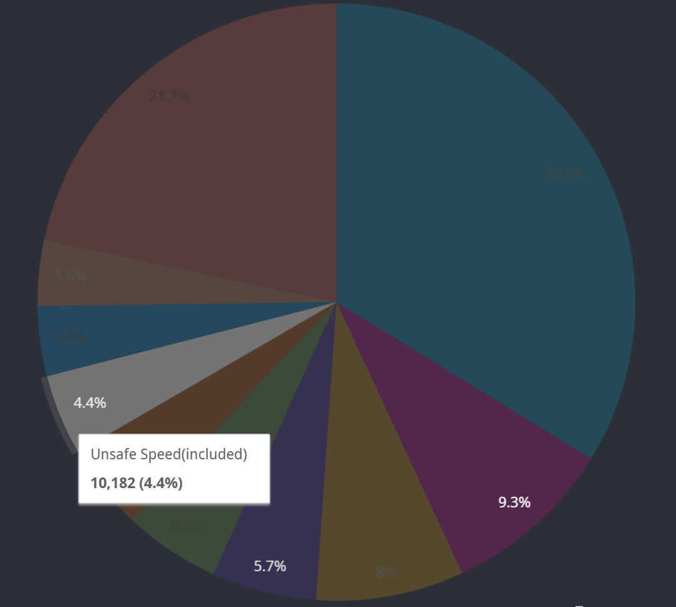
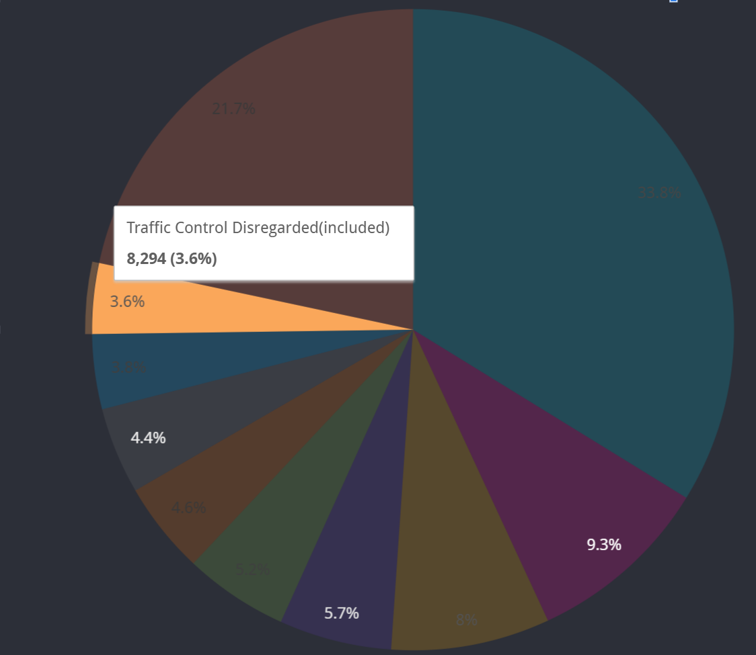
Analysis #1 – Cause Analysis
Passing or Lane Usage Improper
Increase from 3.9% to 5.7%
Unsafe Speed
New Top 10
Traffic Control Disregarded
New Top 10
Notes:
We found out that vehicle in the streets were 30 percent less than pre-covid. And Cars were also moving from 10 to 16 percent faster compared to 2019. this would explain the unsafe speed. Because there are fewer cars in the streets and cars are moving faster, the possibility of more serious car accidents happening also rose.
Another study we found is that the mental health issues were also on the rise during pandemic. We assume that there were more road rage. This also caused the injury and death rate staying high.
https://nypost.com/2020/09/07/how-nyc-traffic-patterns-have-changed-during-covid-19/

Slide 7
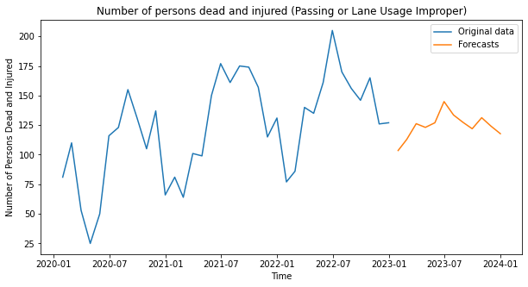
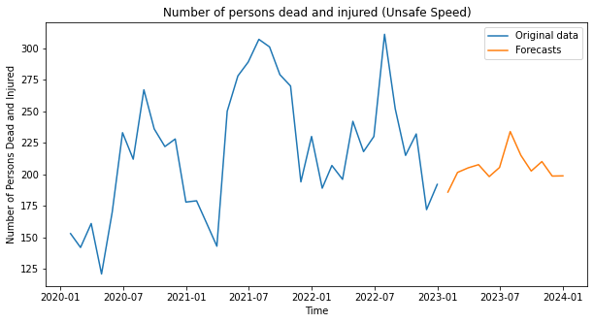
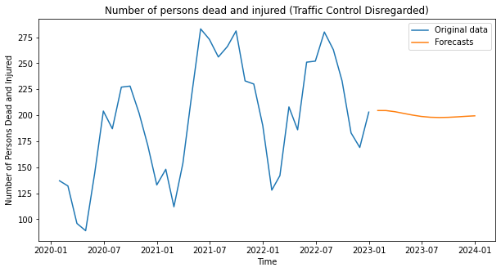
Passing or Lane Usage Improper
Analysis #1
Time Series Forecasting
Unsafe Speed
Traffic Control Disregarded
Notes:
For convenience, we use auto arima, letting python to choose the best model for us. But the predictions seems not that good, might because we only have 3 years monthly data after 2020.

Slide 8

Analysis #1 – Recommendations
Increase enforcement of traffic laws
Reducing speed limits in high-risk areas, adding traffic calming measures, and improving signage
Notes:
Increase enforcement: One of the most effective ways to address these problems is to increase law enforcement efforts to catch and penalize drivers who engage in unsafe behaviors. This can include measures such as increasing the number of traffic police, installing more traffic cameras, and increasing fines for violations.
Improve public education: Public education campaigns can help raise awareness about the dangers of these behaviors and encourage safer driving habits. These campaigns can be delivered through a variety of channels, such as television and radio ads, social media, and in-person events.
Infrastructure improvements: Improving road infrastructure can also help to address these problems. For example, adding traffic-calming measures such as speed humps and roundabouts can help to slow down traffic and reduce the risk of accidents. Other measures such as adding more visible traffic signs and improving road markings can also help to reduce the likelihood of drivers disregarding traffic control.
Encourage safe driving practices: Encouraging drivers to adopt safe driving practices, such as maintaining a safe following distance, obeying speed limits, and avoiding distractions, can also help to reduce the risk of accidents caused by speeding, passing, and lane usage improper.
Use technology: Advancements in vehicle technology can also be used to help prevent these types of accidents. For example, many newer vehicles have advanced safety features such as lane departure warning systems, automatic emergency braking, and adaptive cruise control, which can help to prevent accidents caused by these behaviors.

Slide 9
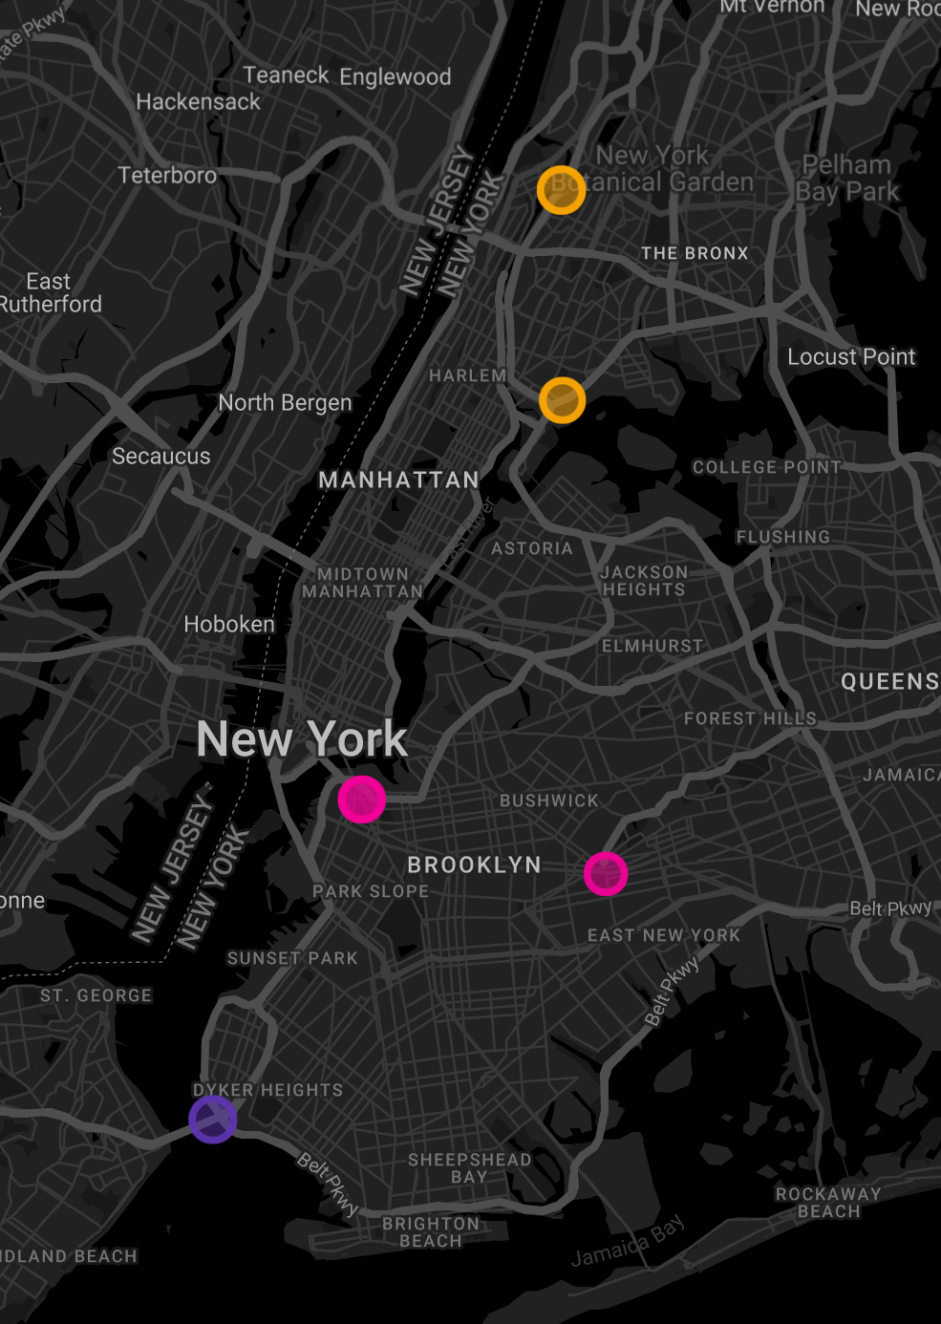
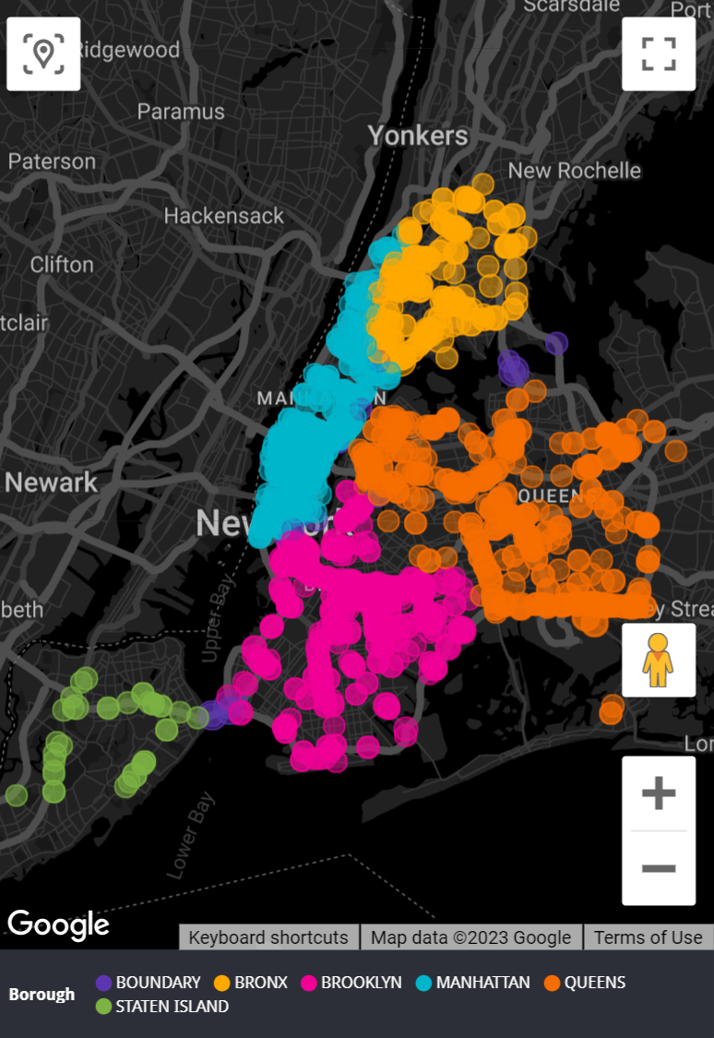
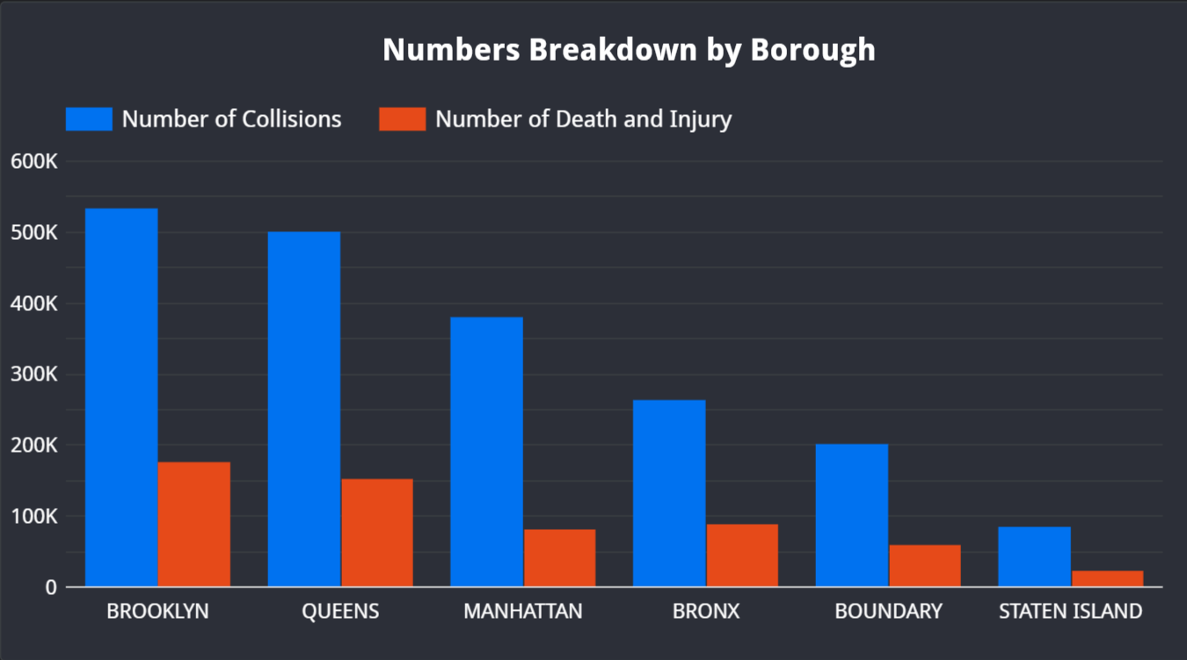
Analysis #2 – Location
Number of Collisions > 500
Further Analysis
9

Slide 10
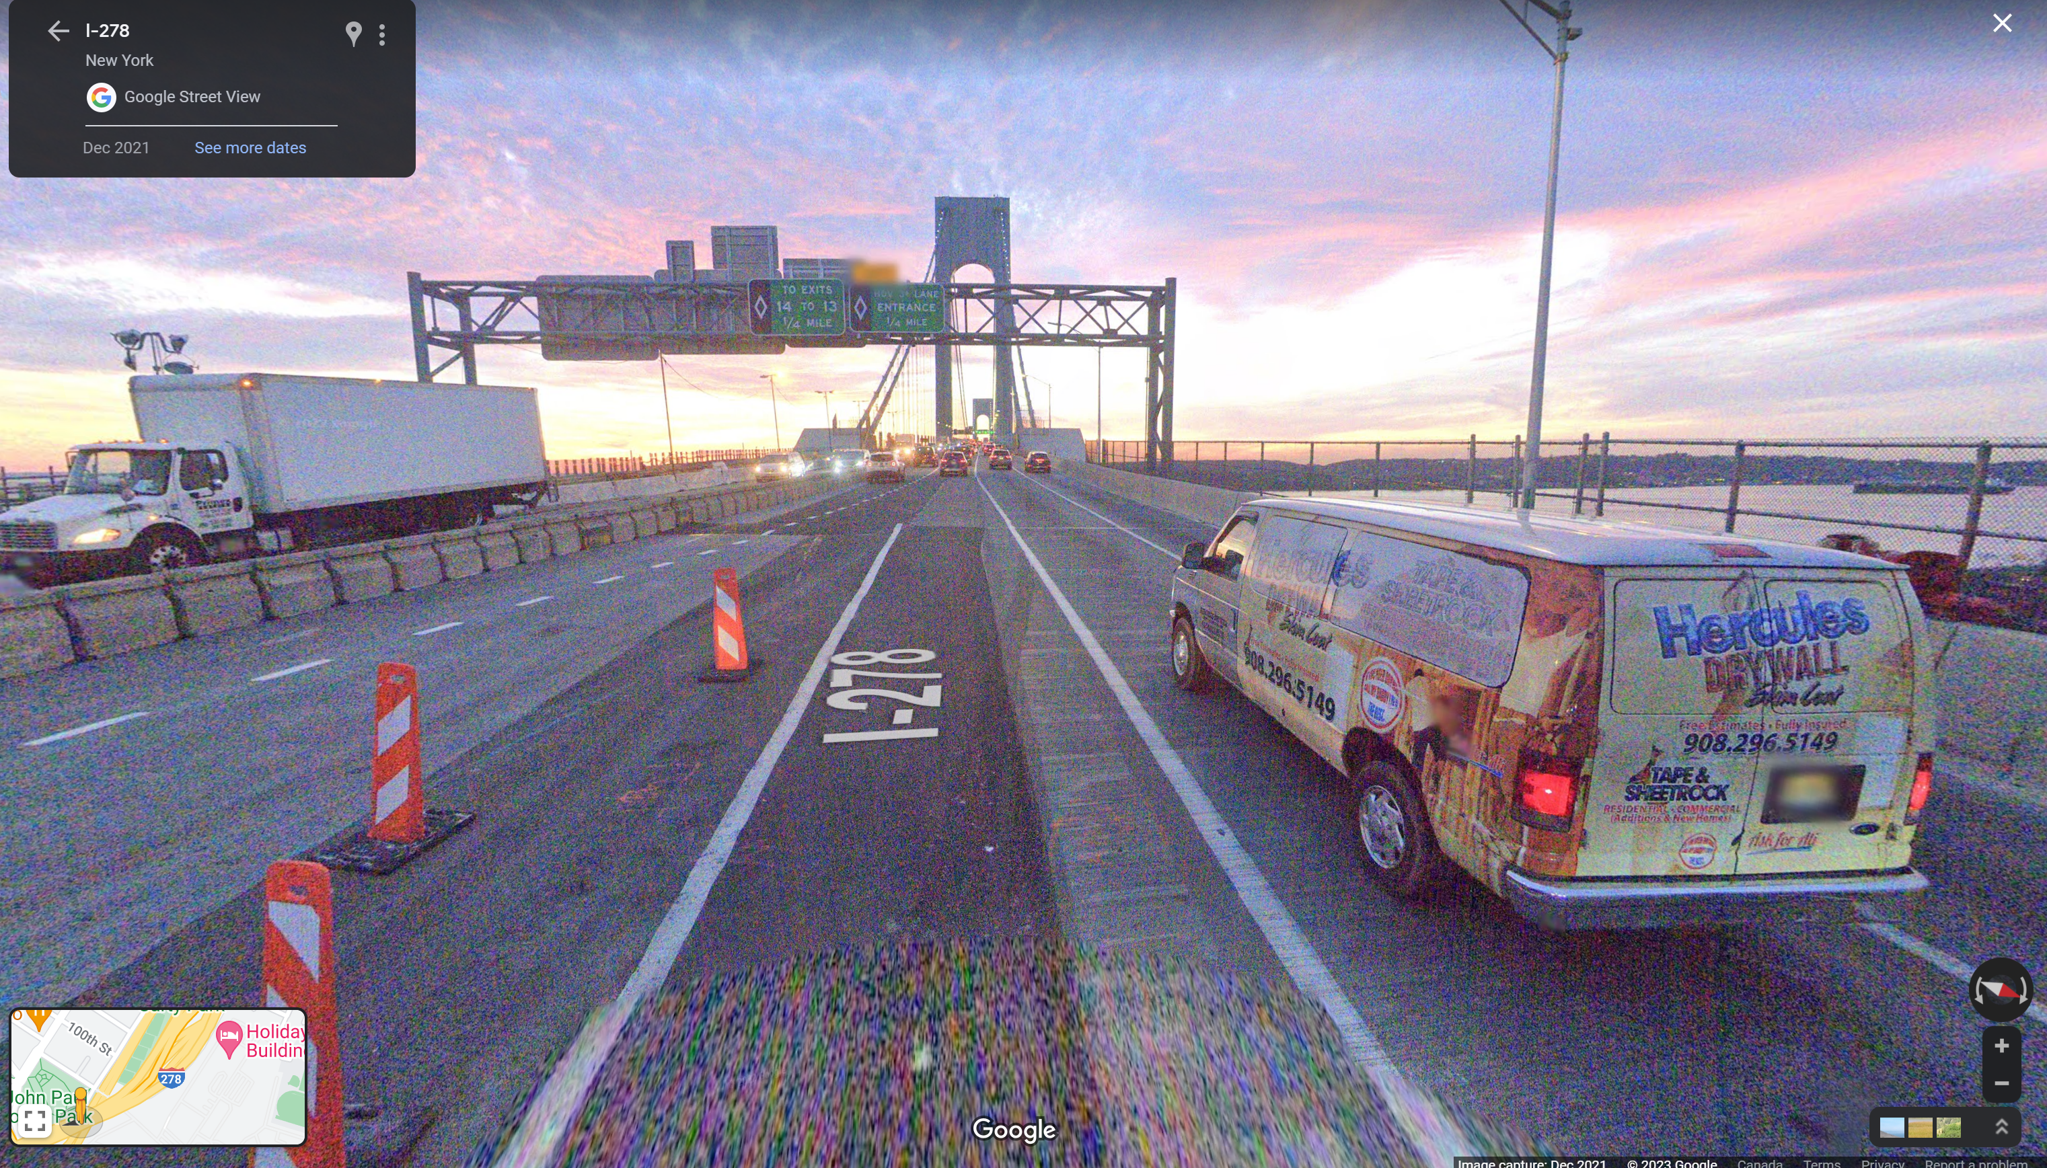
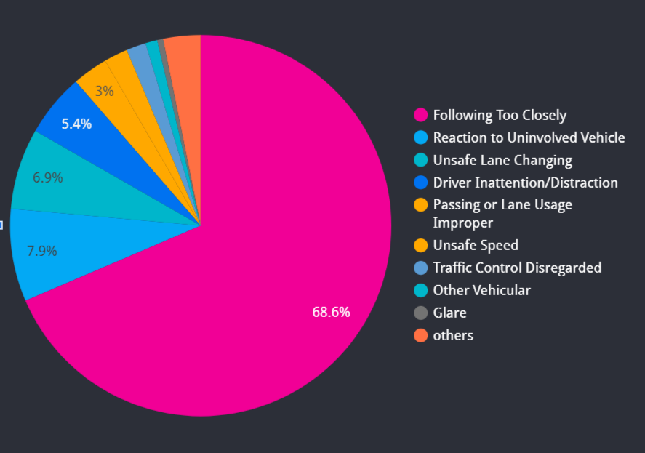
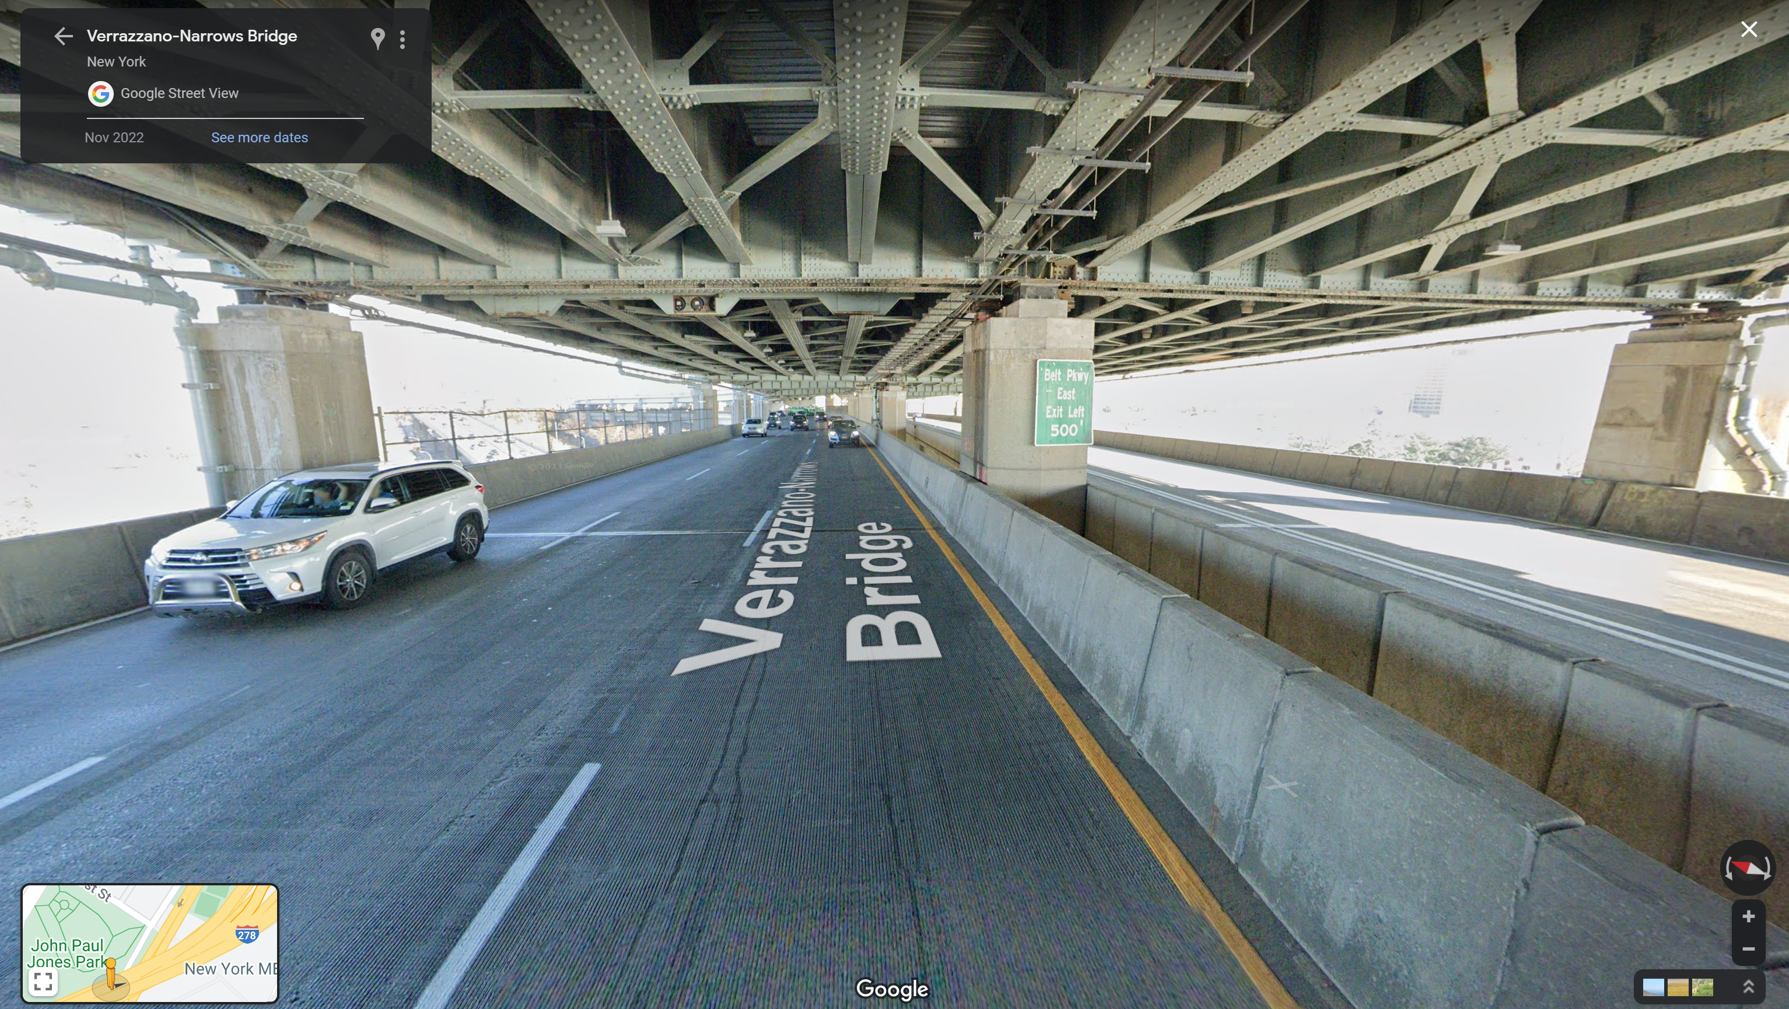
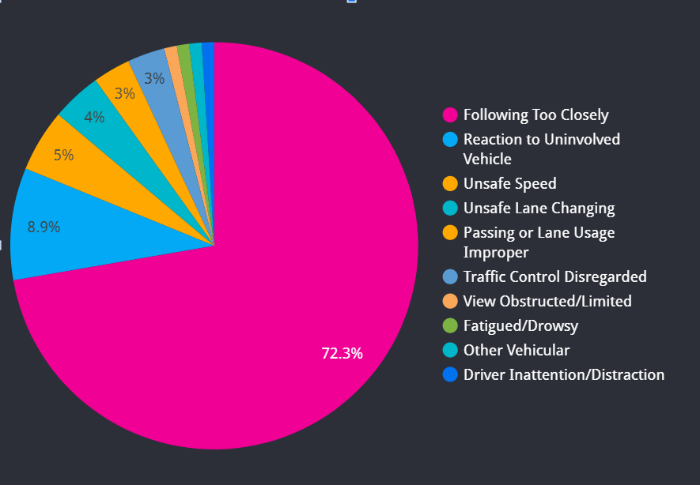
Analysis #2 – Location
Primary
Secondary

Slide 11
Analysis #2 – Recommendations
Public education. Use lower level for small vehicle
Adopt reversible lanes to direct vehicles to different levels based on the real-time traffic

Slide 12
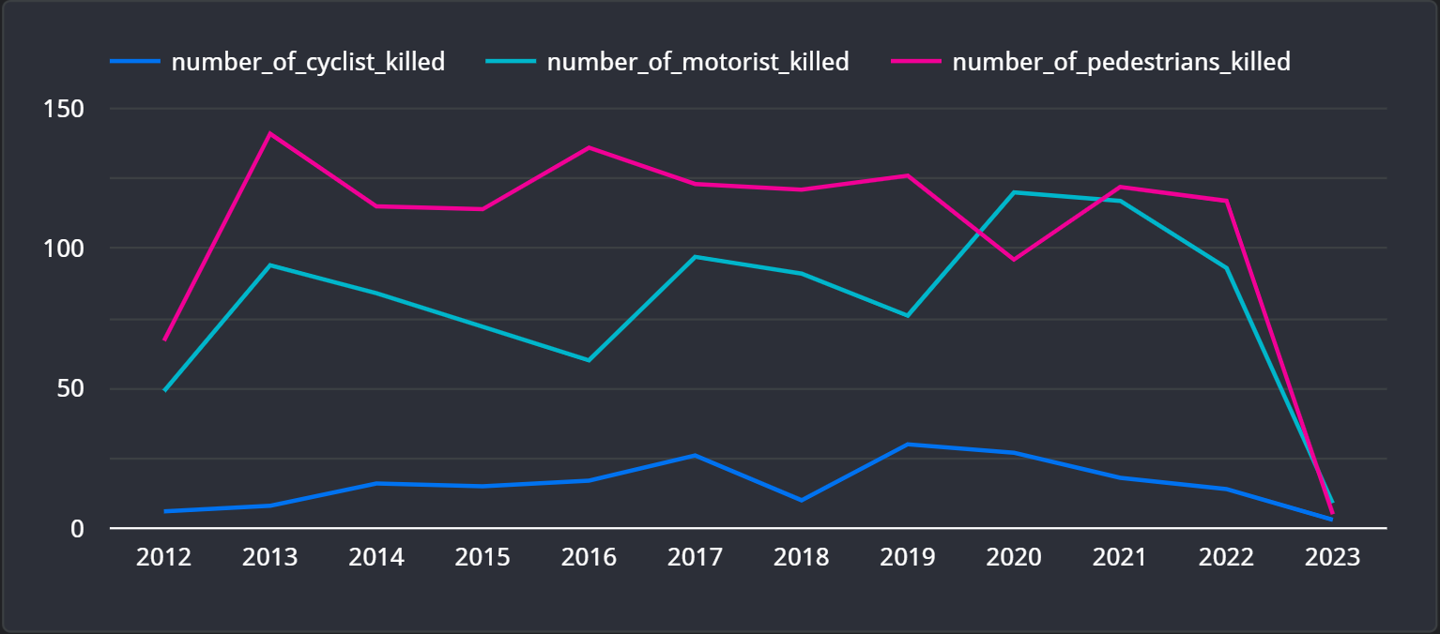
Analysis #3 – Road users analysis
Fatality Rate
Observations
The fatality rate of pedestrians is tremendously larger than the other two groups
Recommendations
Improve the public transit system
Encourage staff-buses or car-pooling
Increase pedestrian visibility and infrastructure
Notes:
Implementing traffic calming measures: This can include reducing speed limits in high-risk areas, implementing traffic-calming infrastructure such as speed humps, and re-engineering roads to make them more pedestrian-friendly.
Increasing pedestrian visibility: Improving lighting in high-risk areas, adding pedestrian crossing signage, and introducing high-visibility markings on crosswalks can all help improve pedestrian visibility.
Improving public transportation: Improving public transportation options such as bus and subway services can help reduce the number of cars on the road, reducing the risk of pedestrian accidents.
Public education campaigns: Raising public awareness about the importance of pedestrian safety can help reduce risky behaviors such as jaywalking and encourage safer behavior on the part of both pedestrians and drivers.
Improving infrastructure: Improving pedestrian infrastructure such as sidewalks, bike lanes, and crosswalks can help create safer spaces for pedestrians.

Slide 13
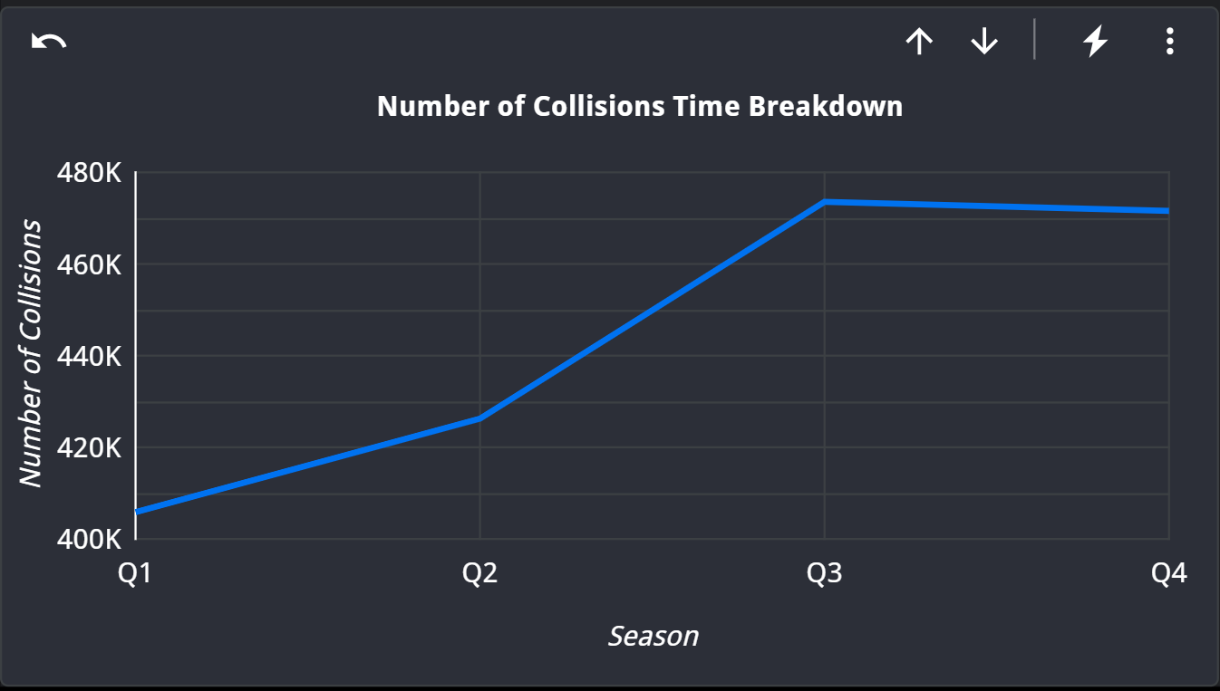
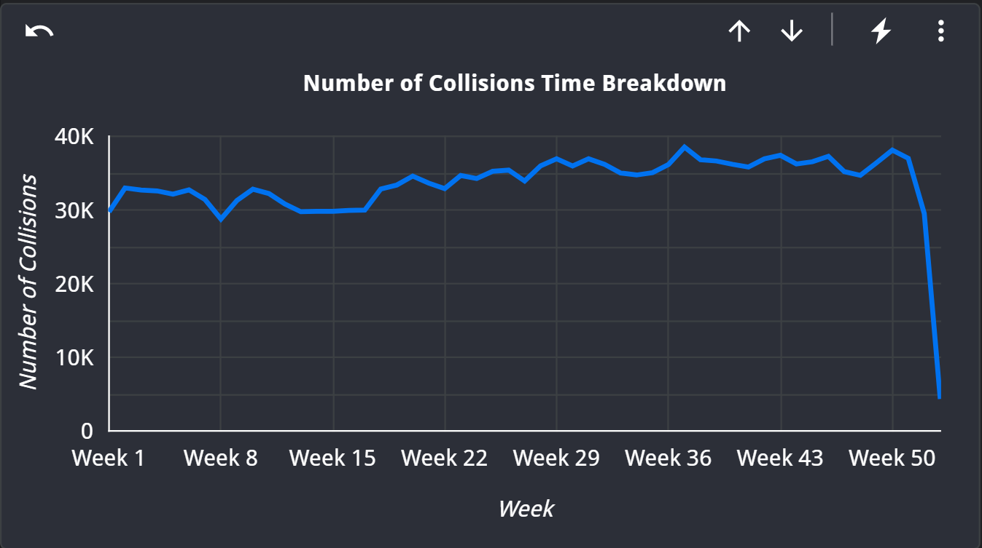
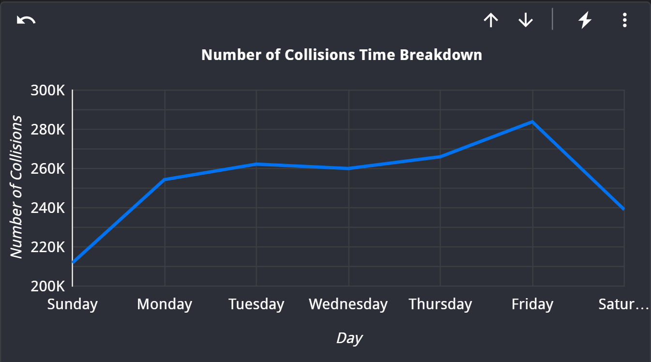
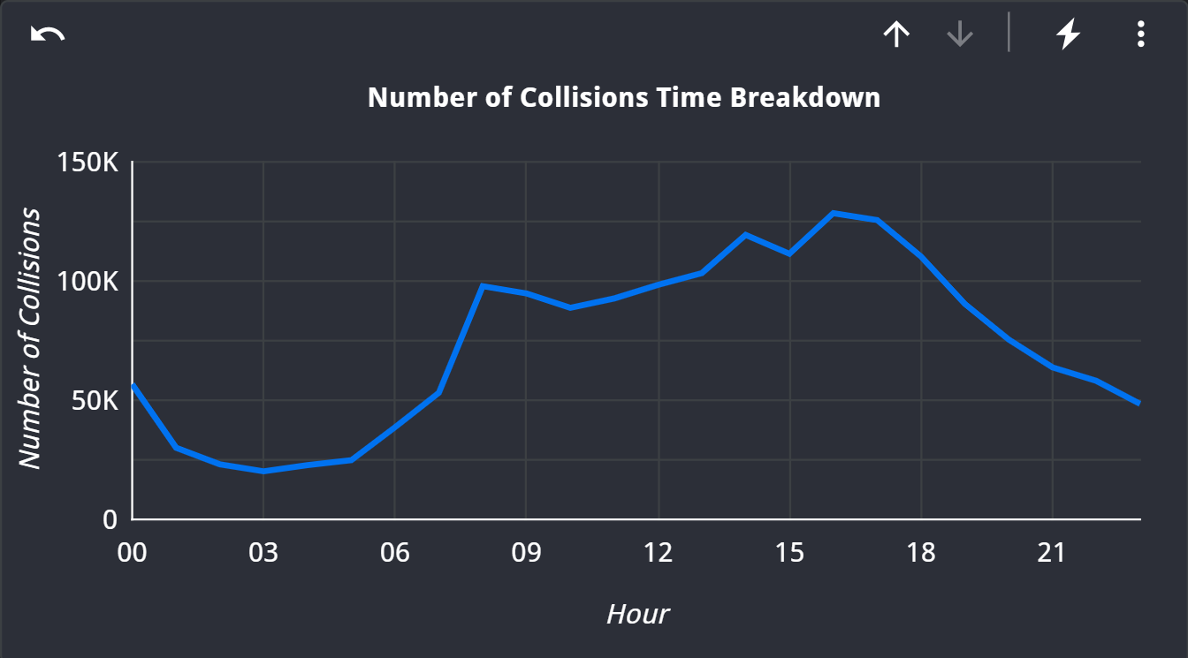
Analysis #4 – Seasonality
Observations:
More accidents during winter, weekends, rush hours
Recommendations:
Deploy additional traffic wardens on times with higher collision rates
Improve the public transit system
Encourage staff-buses or car-pooling

Slide 14

Hypothesis Test
Analysis #5 – Electric Vehicle
Significant Differences
E-scooter and E-bike have higher injury and fatality rates
Recommendations
Different laws and rules for electric scooters and bikes

Slide 15
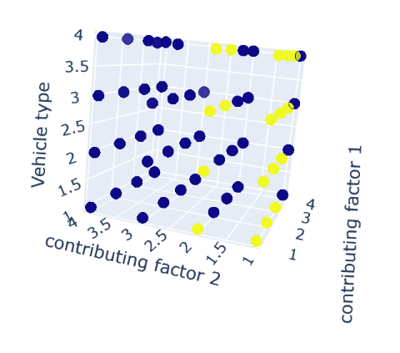
Analysis #6 – Cluster Analysis
Clustering:
contributing_factor_vehicle_1 (top4)
contributing_factor_vehicle_2 (top4)
vehicle_code_1_mod (top4)
 | Contributing_factor_vehicle_1 | Contributing_factor_vehicle_2 | Vehicle_code_1
1 | Driver Inattention/Distraction | Driver Inattention/Distraction | sedan
2 | Following Too Closely | Other Vehicular | station wagon/sport utility vehicle
3 | Failure to Yield Right-of-Way | Following Too Closely | passenger vehicle
4 | Backing Unsafely | Failure to Yield Right-of-Way | sport utility / station wagon
Notes:
First, we tried pairplot to have a look if there is obvious clusters. We didn’t find the obvious clusters, but we find two linear relationship.
The we add a dimension to see whether there are clusters.

Slide 16
Accomplishment
Data Wrangling using both Python and SQL
Borough filling using geopandas package
Dashboard building
Map integration
“On-site” analysis (Google Map image)
Hypothesis testing
Timeseries Forecasting
Cluster Analysis
Death Rate insight revealing

Slide 17

Thank you !

